Slide 1


Optimizing Financial Supply Chains | A Network Approach
shota@prossimotech.com

Slide 2

Fragility
Challenges
Modeling
Possibilities

Slide 3
Fragility
Challenges
Modeling
Possibilities

Slide 4
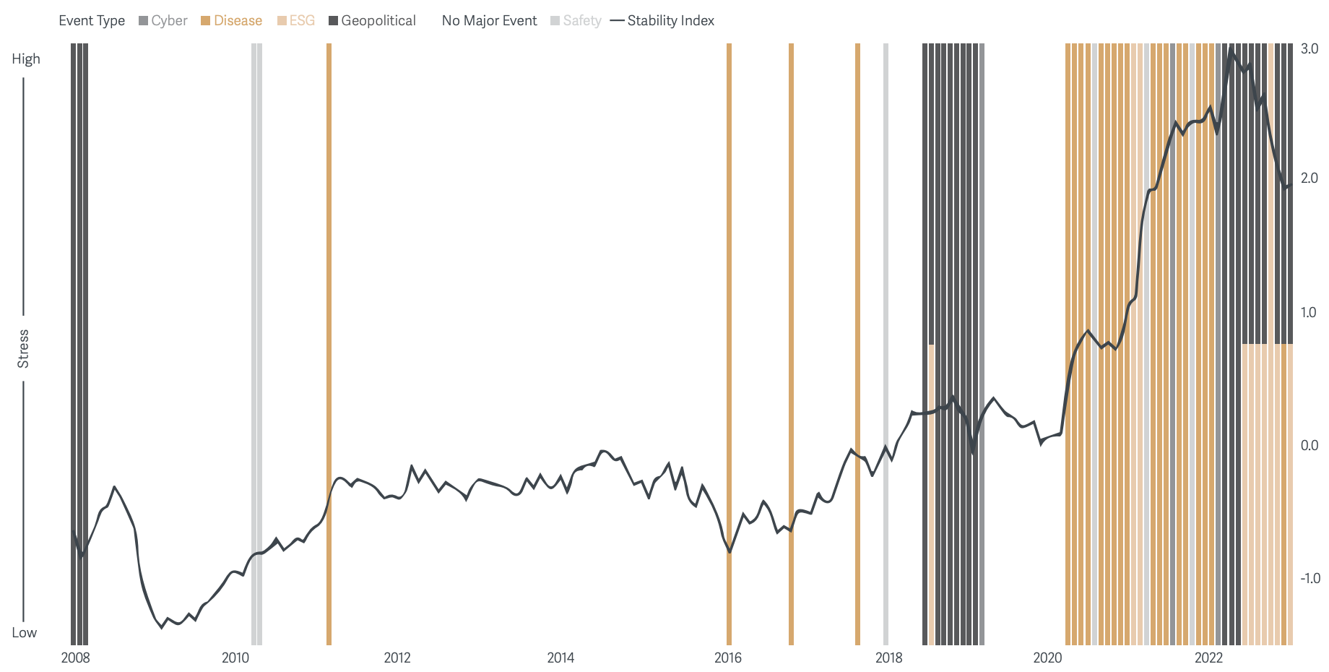
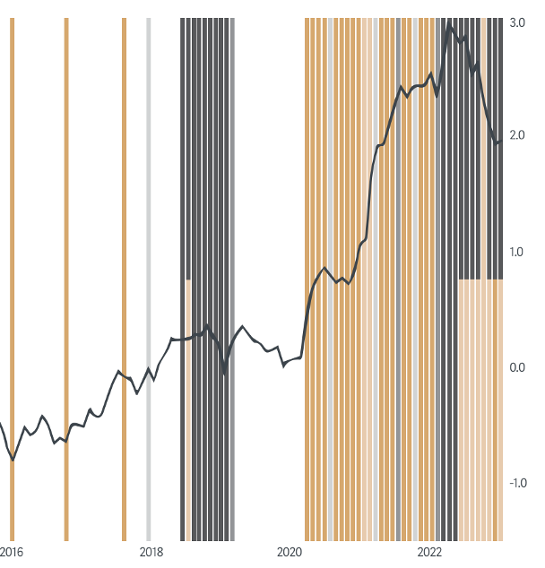
Increasing instability & supply chain risks
Fragility
Source: KPMG & ASCM

Slide 5
With large potential negative profit impact
100-day Supply Chain disruption scenarios: Impact on EBITDA
Average impact on EBITDA:
-42%
-54%
to
Fragility
100 day disruption to:
Source: McKinsey

Slide 6
Forcing a rethink in supply chain management
Survey of Global Supply Chain Leaders: Actions Taken
Increasing Inventory
Dual Sourcing
Regionalization / Near-shoring
Expand Backup Production
85.9%
77.5%
56.3%
32.4%
Fragility
McKinsey, in 2021, n=71
Source: McKinsey

Slide 7
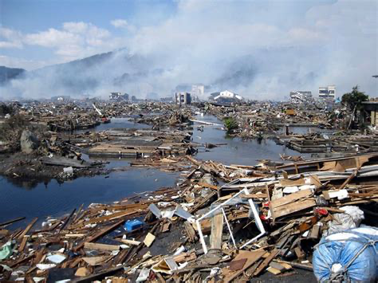
March 2011 Tohoku earthquake & Toyota
Toyota Production (% change relative to previous year)
Fragility
Source: Matuso, Hirofumi -- "Implications of the Tohoku earthquake for Toyota's coordination mechanism: Supply chain disruption of automotive semiconductors",
Kobe University, 2-1 Rokkodai, 10 July 2014 International Journal of Production Economics

Slide 8
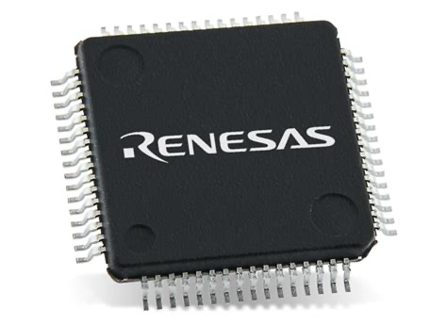
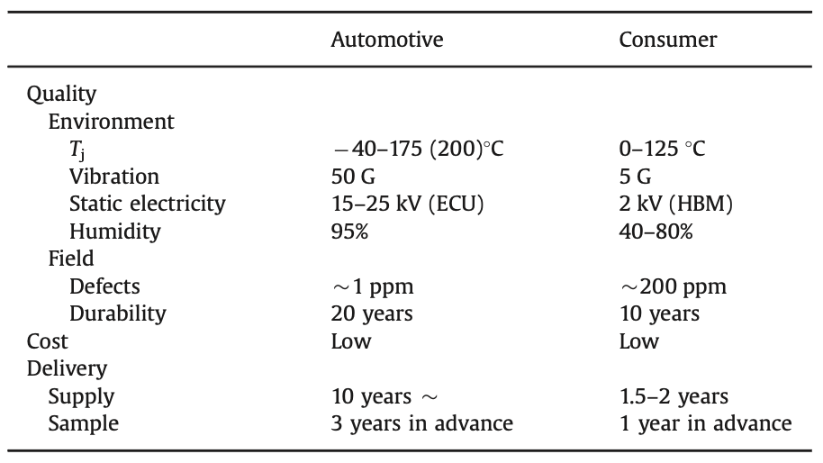
Automotive MCU
Q) Why did Toyota’s supply chain single-source from Renesas ?
A) It’s not that easy to build resilience…
Fragility
Quality Requirements of MCU
Renesas: 44% of Production Share
difficult
of which 1 plant (Naka) was 20%
Source: Matuso, Hirofumi -- "Implications of the Tohoku earthquake for Toyota's coordination mechanism: Supply chain disruption of automotive semiconductors",
Kobe University, 2-1 Rokkodai, 10 July 2014 International Journal of Production Economics

Slide 9
Toyota actions after
1. Create a database of suppliers & parts
2. Multi-source suppliers
3. Hold more inventory
Fragility
4. Regionalize the supply chain
5. Standardize components
> More visibility, simplicity, flexibility and redundancy
Not ”Lean”

Slide 10
Trade-offs
“Efficient”
“Resilient”
Less inventory
More inventory
Fragility
Redundant Suppliers
Single Suppliers
Global
Regional
Lean
Excess Capacity

Slide 11
Fragility
Challenges
Modeling
Possibilities

Slide 12




What is a Supply Chain?
Buyer (root)
$
Supplier (Tier 1)
Supply Chains
Financial
Supply Chain
$
Supplier (Tier 2)
$
Supplier (Tier 3)
etc.

Slide 13
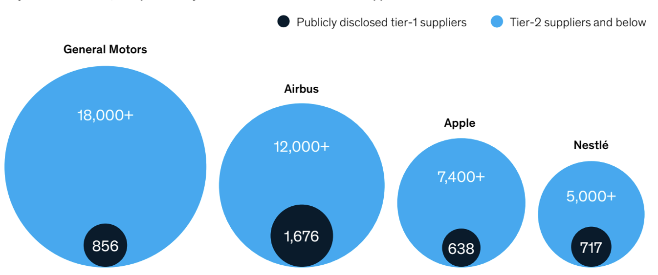
Quantity of suppliers
Challenges
Source: McKinsey

Slide 14
Depth
More visibility
Challenges
Less visibility

Slide 15
Concentration & lack of substitutes
Challenges

Slide 16
Complex interdependence
Challenges

Slide 17
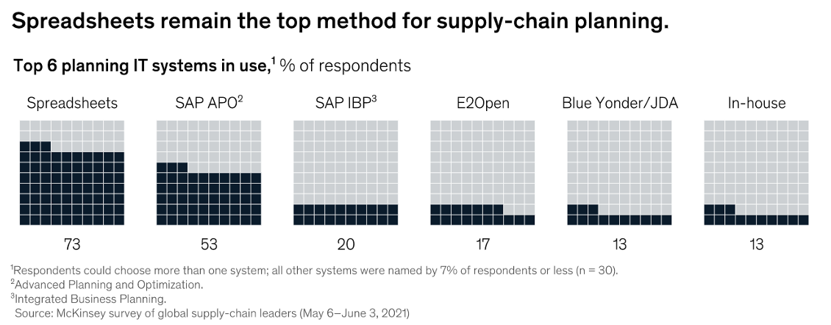
Tooling
Challenges
Source: McKinsey

Slide 18

Disruption
Challenges
1. What’s the loss?
2. Who can supply?
3. How to route?

Slide 19


Financial Supply Chains: less-understood
Challenges
30
30
30
30
days
days
days
days
Cumulative delay
30
60
90
120
Cost of Capital

Slide 20
Fragility
Challenges
Modeling
Possibilities

Slide 21
Nomenclature
root / anchor
competitor
T₀1
T₀2
scope
Supply Chain
Modeling
Tier 1
T₁1
T₁2
Tier 2
T₂1
T₂2
T₂3
T₂4
T₂5
T₂6

Slide 22
Encoded Information
Tier 1
T₀1
Supply Chain
Modeling
S( T₀1, T₁1, $100, 50% )
Tier 2
T₁1
Buyer
Supplier
Amount
Probability

Slide 23
What else matters
Value
Current value amount of transaction
Tenor
Time between invoice issuance and payment
Capital Cost
Cost of Capital (for each party)
Return Cost
Opportunity cost of forgone investment (for each party)
Supply Chain
Modeling
Criticality
How important is the component to the company?
Substitutability
How easy is it to substitute the component?
Other Costs
e.g. ESG costs or other costs
Target Liquidity
Needed liquidity to meet cash contingencies

Slide 24
Toy Model
“sources of capital”
“uses of capital”
financing
financing
payment
payment
Supply Chain
Modeling
sales
T₀1
T₁1
sales
other
investment
other
investment
cash
cash
… and how quickly to pay / get paid

Slide 25
Time value of money
30 day return
Return
Reinvestment
Return
Today
Supply Chain
Modeling
Zero-lag
Payment
settled 30 days later
Settle Today
Payment
Payment
Time
working capital
funding
working capital
funding
Funding Cost
Not needed

Slide 26
Constraints and Objectives
Sources of capital
financing (debt / equity / mix)
sales
cash
dynamic
Lower cost is better
Uses of capital
operations
cash
early payment to suppliers
return generating assets (stocks, bonds, etc.)
Supply Chain
Modeling
Higher return is better
subject to risk
Objective
maximize net returns for 1 company
maximize net returns for all companies
how to distribute?
Constrained by:
minimum cash (liquidity)
criticality / substitutability
other costs

Slide 27
Liquidity Management
Debt Capacity
22
+30
22
no
debt
1
-10
12
-10
2
default
Profit / Loss
-10
-8
0
Supply Chain
Financing
31
Debt Capacity
22
+29
-10
21
default
Supply Chain
Modeling
2
-10
12
-30
-10
Profit / Loss
2
-1
-9
+29
40
Debt Capacity
3
Supply Chain
Financing
31
-30
22
+29
-10
21
Supply Chain
Financing
10
Profit / Loss
-10
12
-2
-10
2

Slide 28
Liquidity Management
Expected Cash needed over horizon
Supply Chain
Modeling
Liquidity
VaR
Cash
level
Default point
Target
Liquidity
Find a Target Liquidity (average cash level over a certain horizon) such that the probability of the cash level being falling below the Default Point is X%

Slide 29
Control Variables
root / anchor
costs
T₀1
returns
Price: What price does T₀1 pay?
Tenor: How quickly does T₀1 pay?
constraints
scope
Supply Chain
Modeling
Tier 1
costs
T₁1
T₁2
costs
returns
returns
constraints
constraints
costs
costs
costs
returns
returns
returns
constraints
constraints
constraints
Tier 2
T₂1
T₂2
T₂3
T₂4
T₂5
T₂6
costs
costs
costs
costs
returns
returns
returns
returns
constraints
constraints
constraints
constraints

Slide 30
Model Scaffolding
Directed acyclic graph
Can be made probabilistic (Bayesian network)
Penalty as a function of tradeoff in time and costs
Cost of capital / liquidity needs / etc. are constantly changing
Production and payments can fluctuate over time
Possible disruptions in the network (probabilistic)
Dynamic over time
Flow of capital
Network structure itself
Supply Chain
Modeling

Slide 31
Why is this novel?
Most prior work focuses on physical supply chains, not financial supply chains.
Current financing approaches are focusing around providing credit to bide the liquidity requirements, not to optimize the uses and deployment of capital.
Most current tools facilitate tactical, bilateral transactions, not strategic capital optimization for the whole supply chain.
Supply Chain
Modeling

Slide 32
Data Challenges
Data availability and quality are uneven
Difficult to get complete picture of the entire supply chain
Need to work directly with client’s suppliers to complement existing data – slow
Data are often outdated (for supply chain relationships)
Need to estimate bargaining power qualitatively
Data not granular
Total annual sales, but not invoice by invoice
Different products and customer segments
Current data (FactSet)
Supply Chain
Modeling
Sources：FactSet

Slide 33
Fragility
Challenges
Modeling
Possibilities

Slide 34
Cash Conversion Cycle
The CCC metric that expresses the length of time (in days) that it takes for a company to convert its investments in inventory and other resources into cash flows from sales.
CCC = DIO + DSO - DPO
Days Inventory Outstanding
DIO = Average Inventory / COGS x 365 Days
CCC
Days Sales Outstanding
DSO = Average Accounts Receivable / Revenue x 365 Days
Days Payable Outstanding
DPO = Average Accounts Payables / COGS x 365 Days
Shorter CCC is “better”: faster conversion to cash.
Sources：https://www.investopedia.com/terms/c/cashconversioncycle.asp

Slide 35
Cash Conversion Cycle: Toyota vs. Tesla
107.4 days*
days
Automobile Industry Average: 84 days
CCC
Difference
108.7 days
-1.26 days
TOYOTA
TESLA
TOYOTA: FY2022 to Mar 2023
TESLA: FY2022 to Dec 2022
Sources：FactSet
Includes financing to distributors. We belive this should be counted as well, as it’s a conscious company strategy and use of capital.

Slide 36
If Toyota and Tessa equalized their CCC
0
-1.26 days
54.4 days
107.4 days
54.4 days
TESLA
TOYOTA
CCC
Change in EBIT
-20.8%
+11.5%
-2.8 Billion USD
asymmetric impact!
+2.3 Billion USD
Cost of Debt
6.20%
0.12%
ROCE
Return on Capital Employed
16.72%
due to huge differential
5.70%
TOYOTA: FY2022 to Mar 2023
TESLA: FY2022 to Dec 2022
Sources：FactSet

Slide 37
Common suppliers as indirect leverage
Marginal impact of Toyota matching Tesla’s payable days.
TESLA
DPO: 91.9 days
TOYOTA
DPO: 62.5 days
CCC
implication
(1) Pay slower
(3) Make Tesla pay faster or
raise price
DPO→ 91.9 days
benefit: +16.9 Million USD
Panasonic
DSO: 65.4 days
→ 94.8 days
impact: -27.7 Million USD
Analysis based on a hypothetical scenario where total sales of Panasonic’s Energy segment (aprrox 7.2 Billion USD) )is split evenly between Toyota and Tesla.
Sources：FactSet, Prossimo

Slide 38
Unbundling the Cost of Goods (COGS) from the Cost of Capital
Price
Required Return
Unbundling components of price
Cost of Capital
Typically Unpriced
Margin, Duties, Taxes
Cost of Goods
Tenor

Slide 39
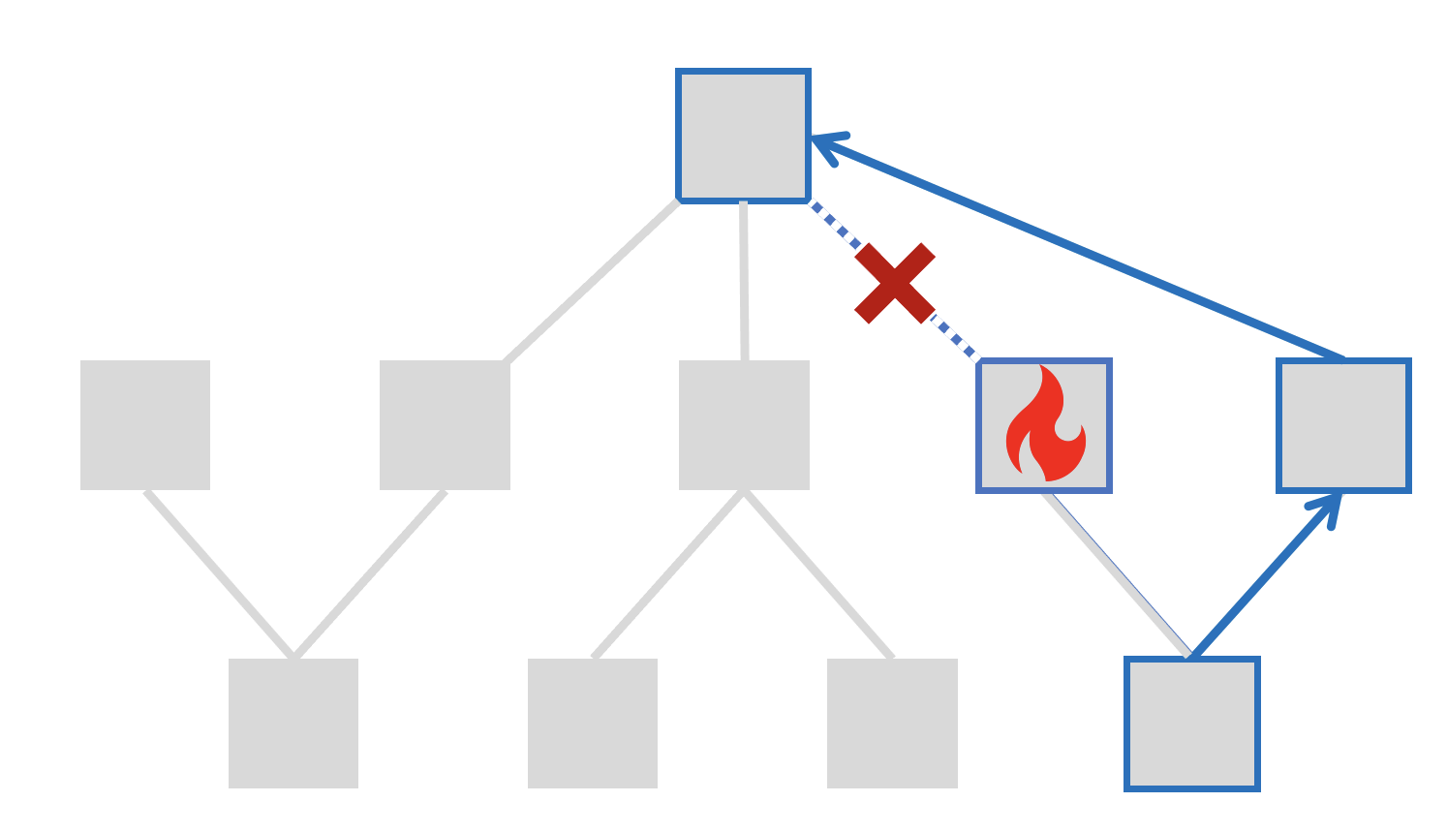

Unbundling the Cost of Goods from the Cost of Capital
Disruption Scenarios
Price
Unbundling components of price
Required Return
Cost of Capital
Margin, Duties, Taxes
Cost of Goods
Tenor
Intelligent Orchestration

Slide 40
Early Payment Discount
30 day return
Return
Reinvestment
Return
Today
Pay your suppliers earlier for a discount!
ACOS (Active Capital Optimization System)
Early Payment
Zero-lag
Payment
settled 30 days later
Settle Today
Payment
Payment
Time
working capital
funding
working capital
funding
Funding Cost
Not needed

Slide 41
The Recursive Set-up
Choices for deployment of capital
Optimize
cash
treasury
T₀1
bonds?
discount
stocks?
faster payment
Supply Chain
Modeling
crypto?
Tier 1
T₁1
T₁2
discount
faster payment
Tier 2
T₂1
T₂2
T₂3
T₂4
T₂5
T₂6

Slide 42
Accounting
100
45
Discount for faster payment reduces the COGS expense
Accounting
55
35
20
15
5
Revenue
COGS
Gross
Margin
OpEx
Operating
Income
(EBIT)
Other
Income / Expenses /
Taxes
Net Income

Slide 43
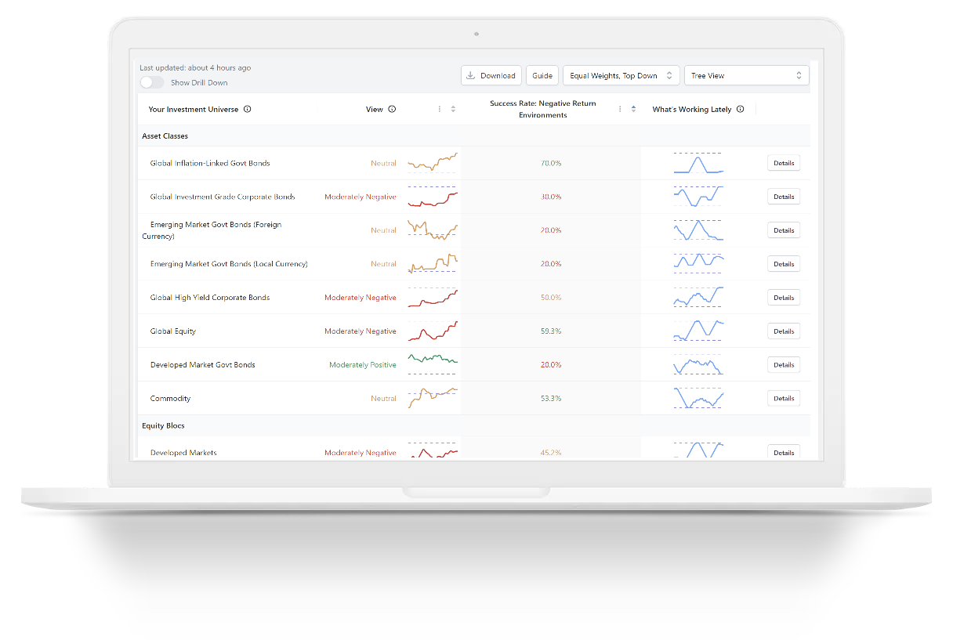
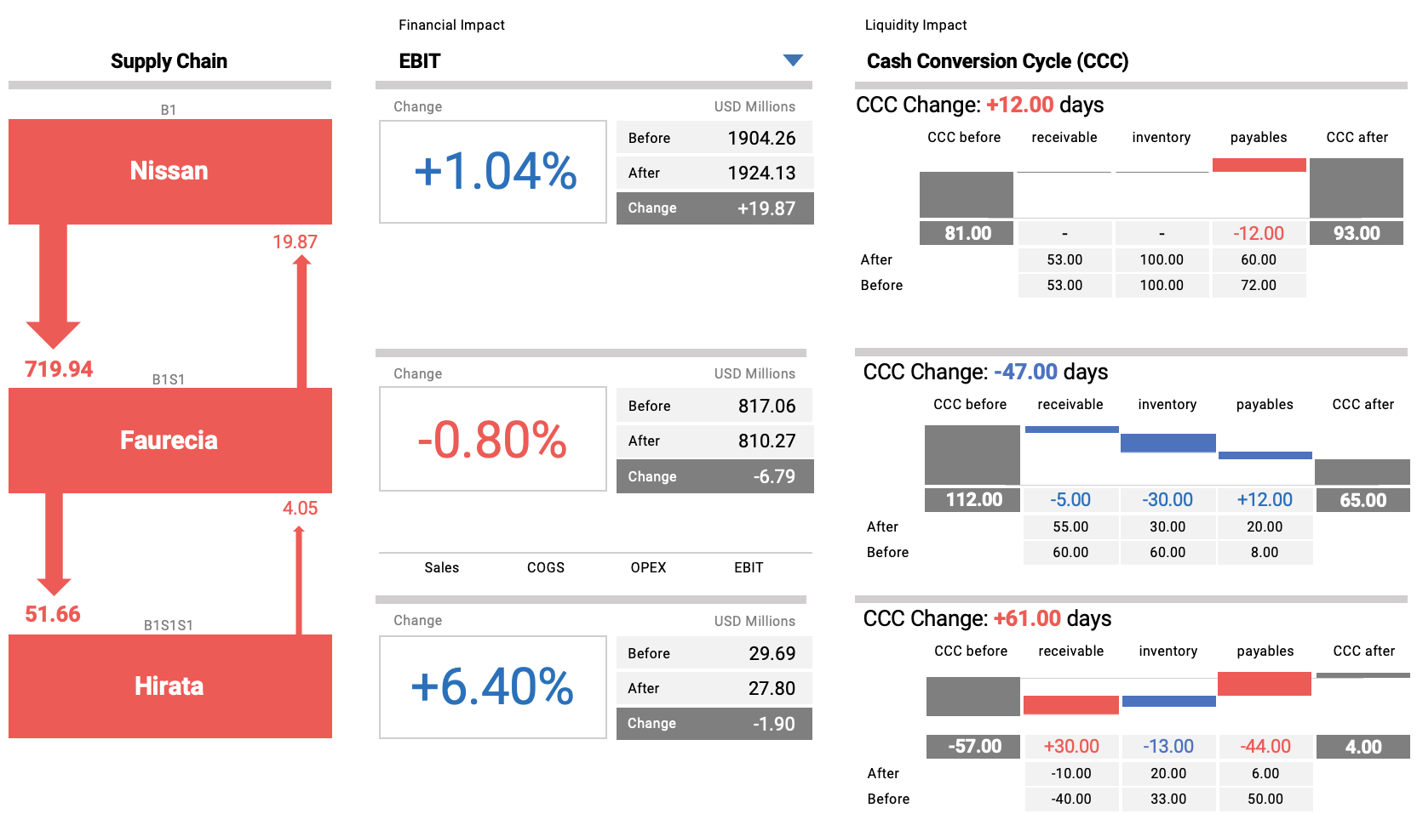
ACOS (Active Capital Optimization System)
TOYOTA
TOYOTA
EBIT increase
+0.9%
Pay
DPO: 56 days
COGS Reduction
$254 Million
Discount
Discount
→ to ZERO-LAG
Liquidity Marketplace
AISIN
EBIT increase
+2.7%
Impact
COGS Reduction
$41.3 Million
DPO: 74 days
Pay
Discount
Discount
→ to ZERO-LAG
EXEDY
Intelligent liquidity & capital orchestration
Source: Prossimo

Slide 44
Returns available in ACOS
Suppliers typically offer
1~6% discounts for a
30 day early payment,
depending on the industry
Impact
….with no market risk or lock-up
Source: Citi Global Wealth Outlook 2023: https://www.privatebank.citibank.com/newcpb-media/media/documents/outlook/outlookwealthreport2023.pdf

Slide 45
Dollar Value EBIT improvement across parameter choices
Broad Parameter Sweep for 3 companies
Sum of EBIT change
win-win-win
Impact
win-win-win
win-win-win
& max value creation
win-win-win
Red: Lower EBIT than before
Green: Higher EBIT than before

Slide 46
Re-tooling for results
Survey of Global Supply Chain Leaders, April 2022 (n=113)
Master Data
53% have sufficient / high-quality Data
Digital Twin
67% Implemented End-to-End Visibility
Impact
Organizational Realignment
Analytics
37% performed Scenario analysis
Network & Procurement Control
Source: McKinsey

Slide 47
A Representation Framework
Geography
“Digital Twin”
Physical Supply Chain
Extensions
Financial Supply Chain
Source: KPMG & ASCM

Slide 48
Towards Intelligence
Learning, Inference and Prediction
Scenario A
Extensions
Scenario B
Scenario C
Time
Source: KPMG & ASCM

Slide 49
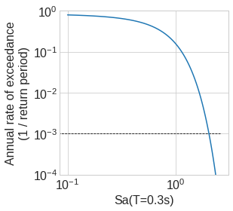
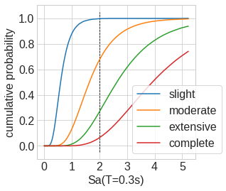
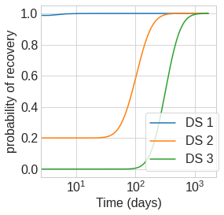
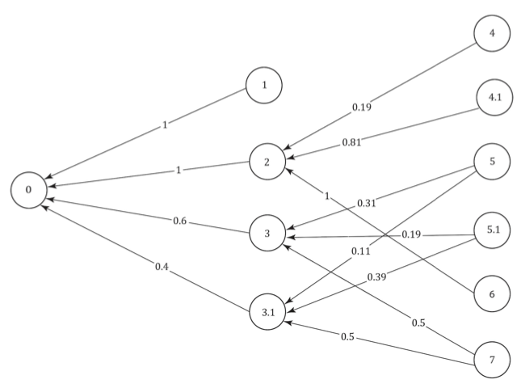
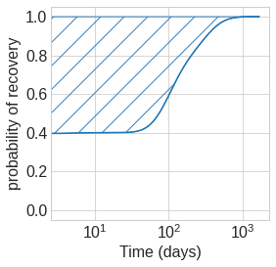

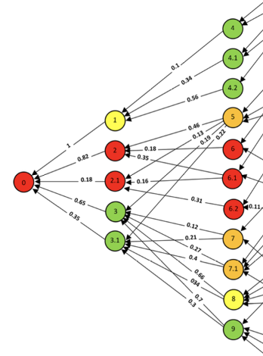
Hazard Scenario
Peril/Disruption
Downtime/Recovery
Network
Loss
Extensions
Monte-Carlo
Simulation
Propagation
Total Impact
Modeling Approach (example)

Slide 50
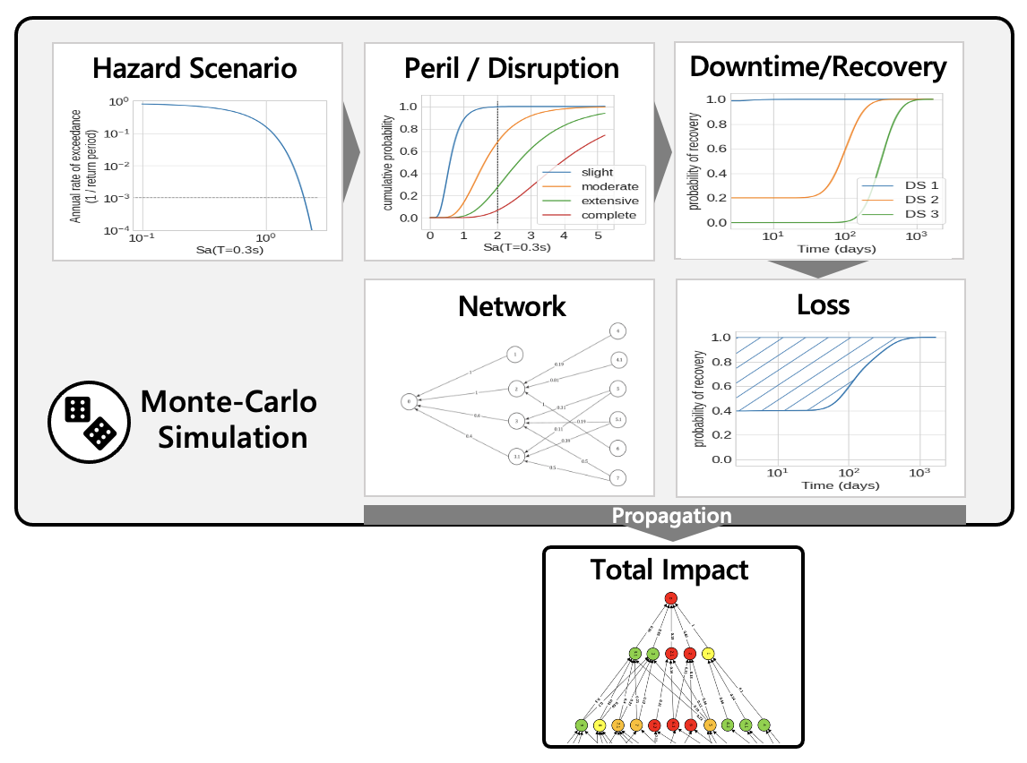


Extensions
Other data
Human-in-the-loop
Learning

Slide 51
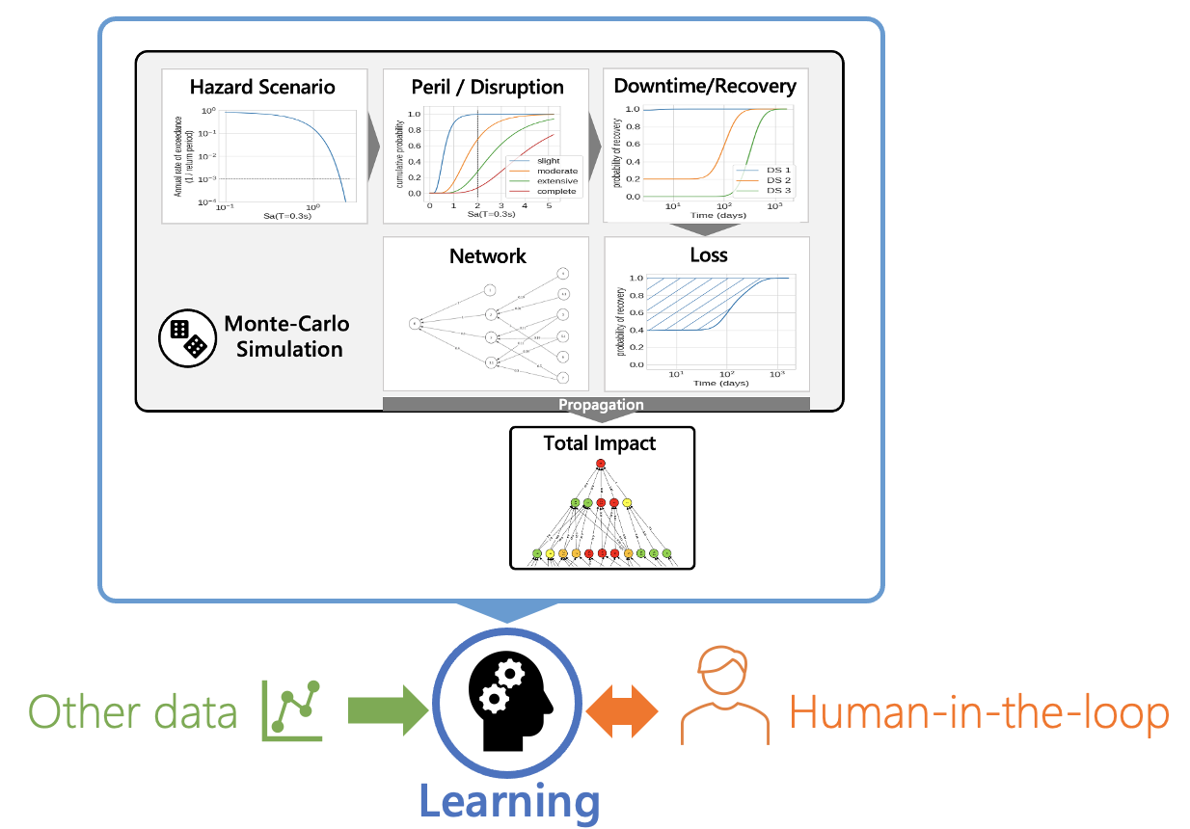








Extensions
IoT Sensors
Blockchain
Governance
Data & Compute
Infrastructure
Public info

Slide 52
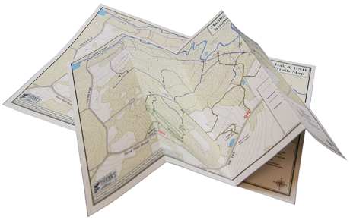
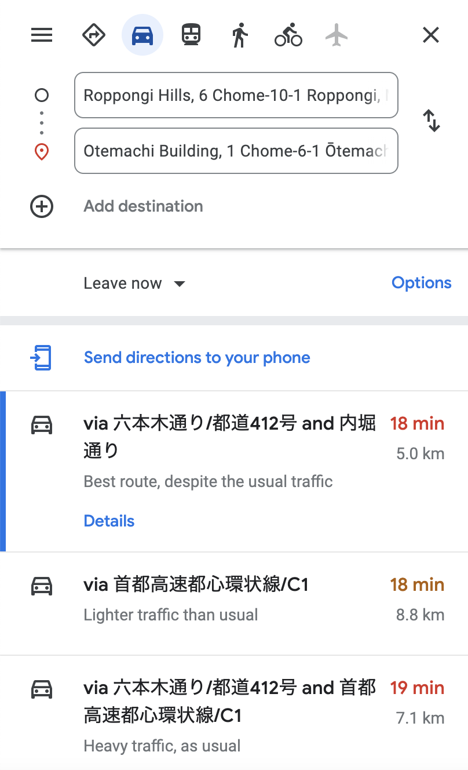
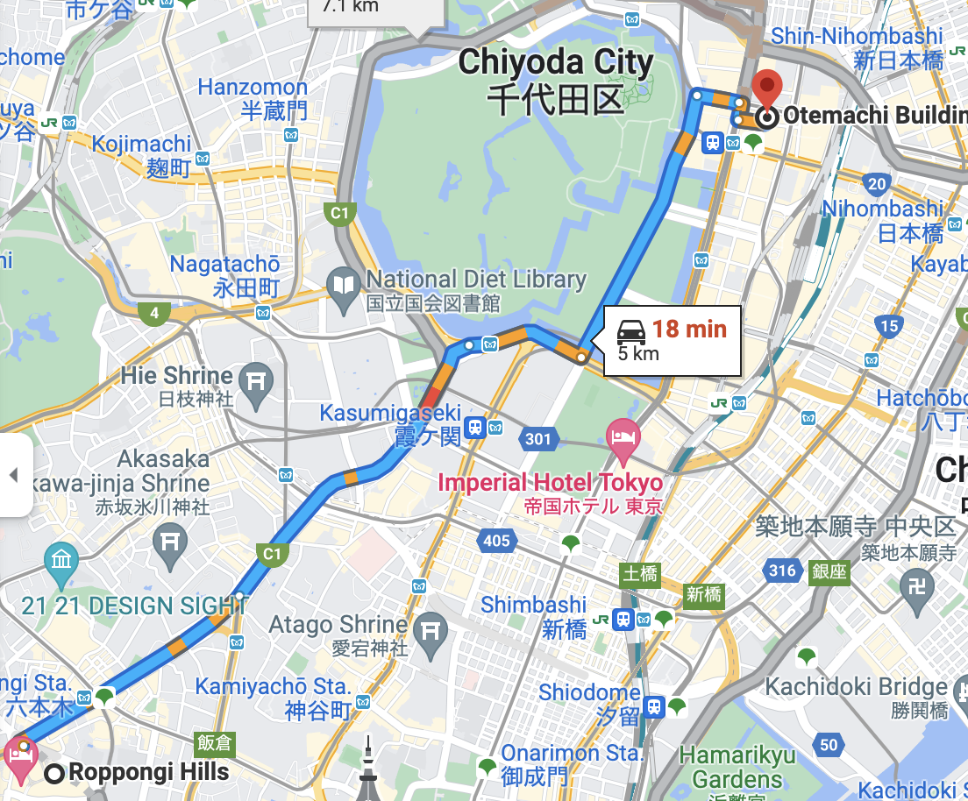
What we want
Extensions
Real-time
Data-driven
Actionable
Source: McKinsey

Slide 53







Current
Extensions
People, ERP & Spreadsheets

Slide 54




Intelligent Supply Chains
Extensions
Intelligence

Slide 55

Data and Intelligence-Driven
Data and Intelligence-Driven Supply Chain Orchestration
“Efficient”
“Resilient”
Less inventory
More inventory
Extensions
Redundant Suppliers
Single Suppliers
Global
Regional
Lean
Excess Capacity

Slide 56


Contact
Shota Ishii | 石井正太
shota@prossimotech.com
www.prossimotech.com

